Slide 1
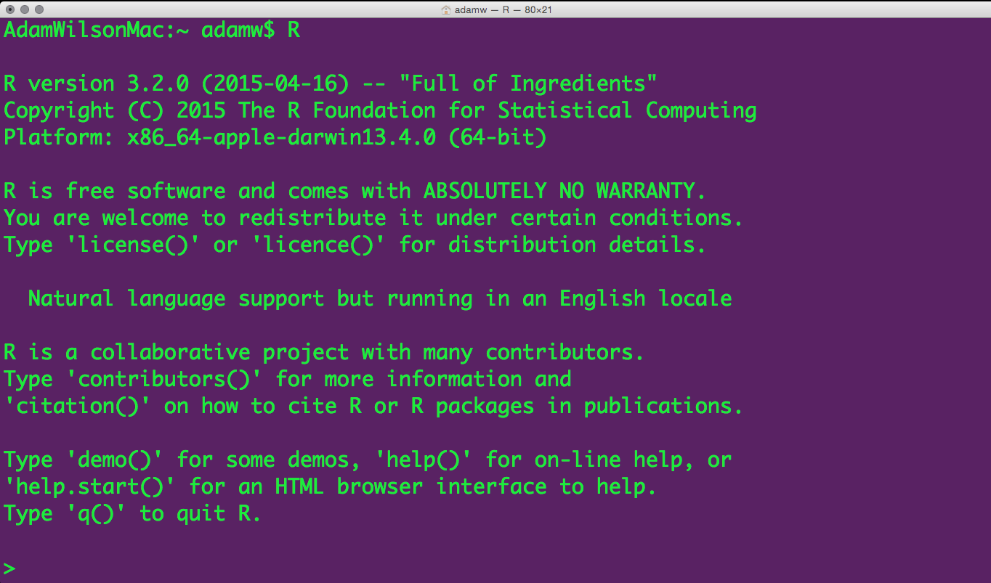
A few logistics…

Slide 2
Course Logistics
Course Participation 10% Package Presentation 10% Homeworks 30% Final Project 50%
On the screen

Slide 3
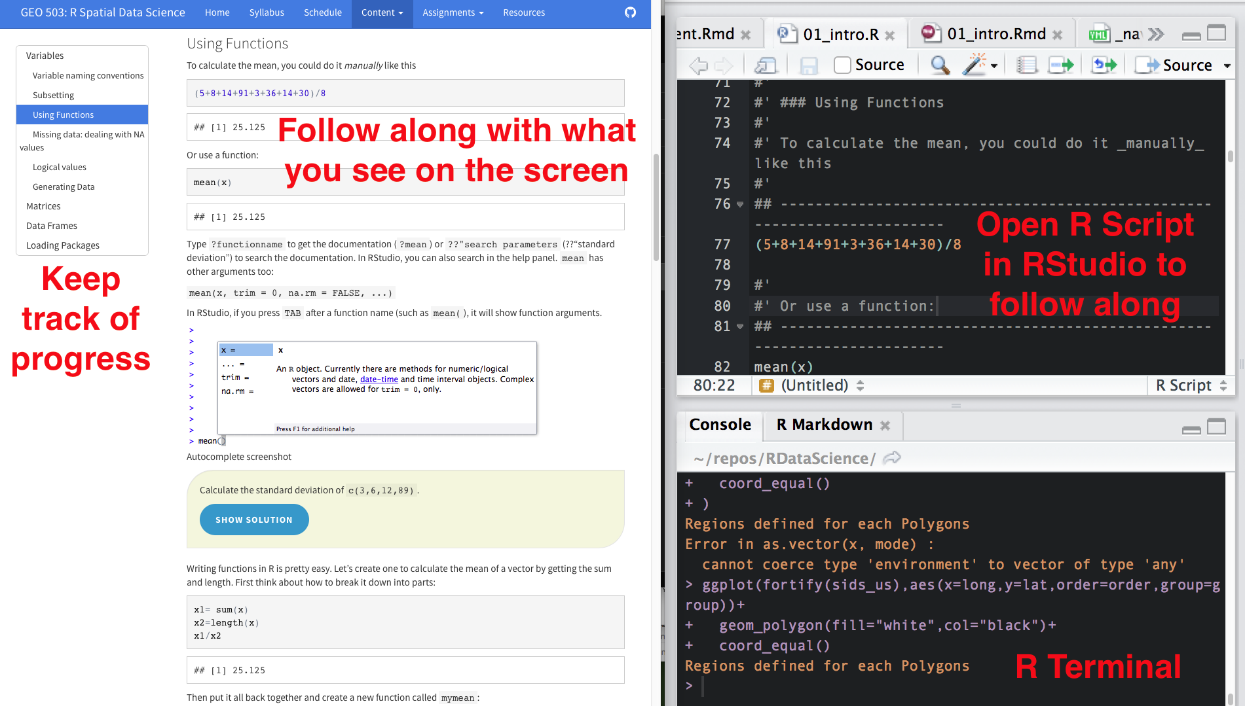
Course Participation (10%)
On the screen

Slide 4
Package Introduction (10%)
Introduce R package relevant to your research interests during a class session.
Objectives:
Learn how to find/download/install a new package and learn how to use it
Teach your peers about useful R packages
5 minute presentation :
What does the package do? (1-2 slides, 1 minute)
Author introduction (1 slide, 1 minute)
Simple demonstration (2-3 slides, 3 minutes)

Slide 5
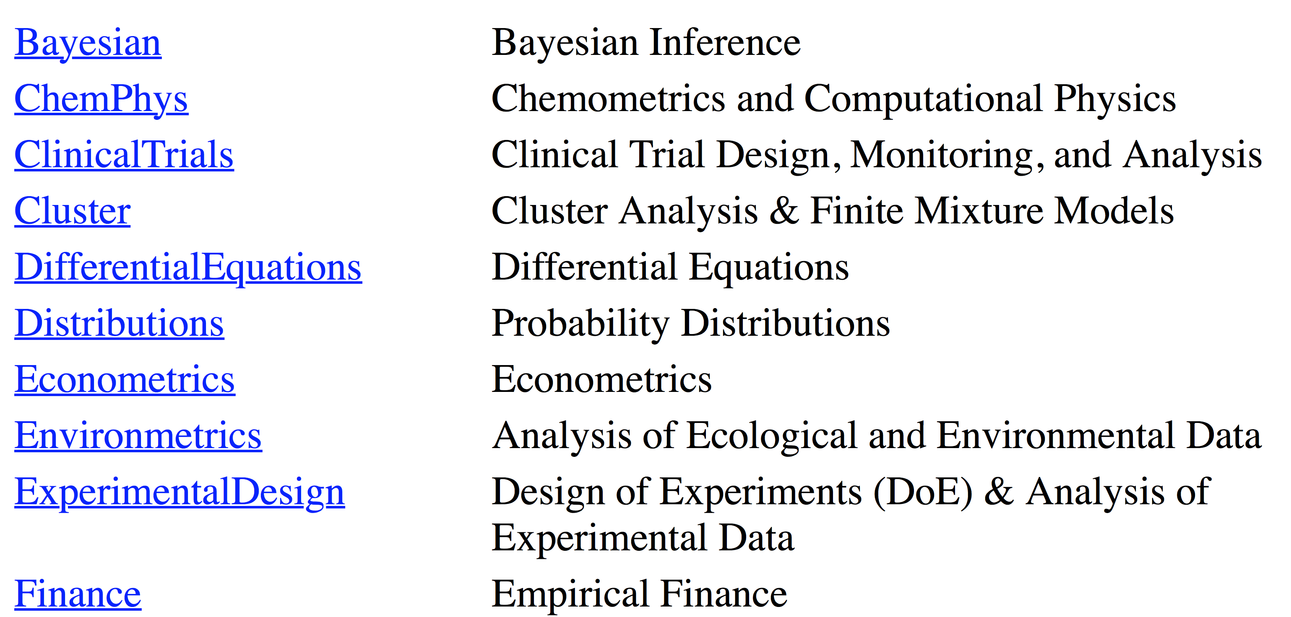
CRAN Task Views
https://cran.r-project.org/web/views/

Slide 6
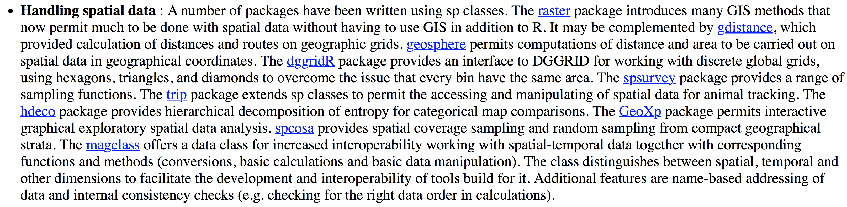
“Spatial” Task view

Slide 7
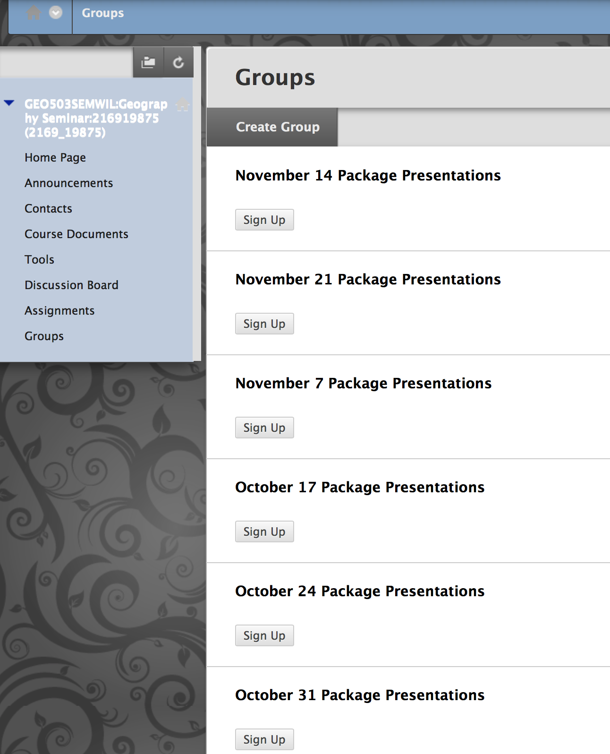
Sign up on UBLearns

Slide 8
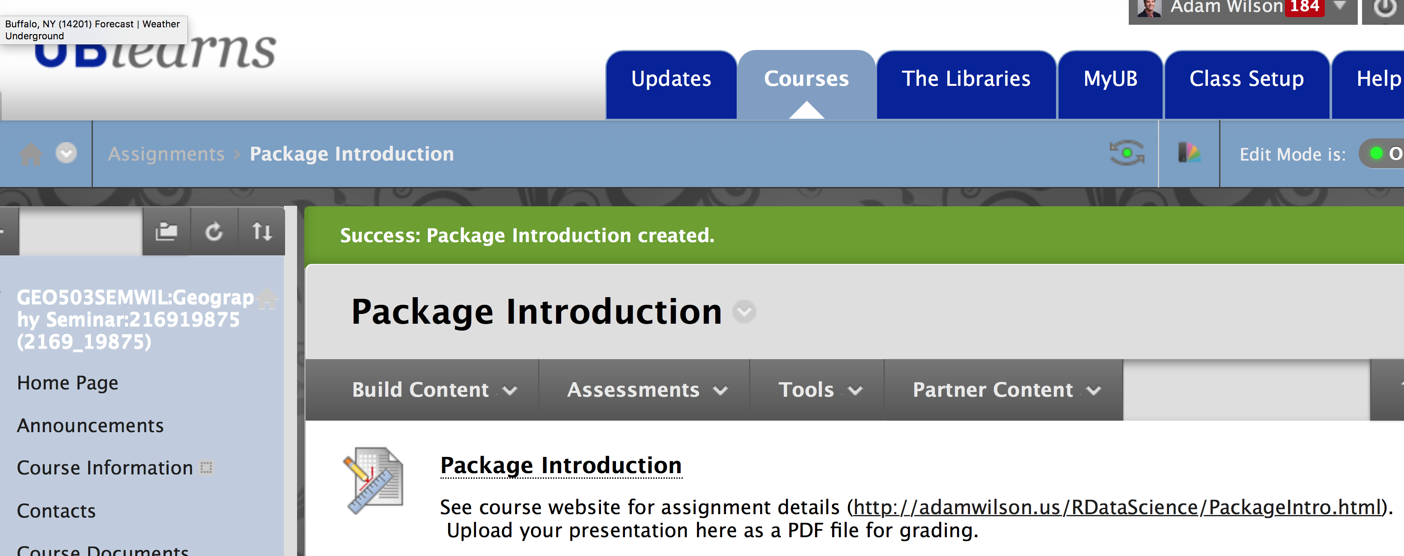
Upload PDF of presentation to UBLearns before you present!

Slide 9
Final Project & Presentation
Infographic/Poster
10/10 Project proposal due (<1 page, 5 points)
10/31-11/7 First draft: Peer review (5 points)
11/14: Second draft of final project (5 points)
12/14: Final project presentations (35 points)
Requirements
The project must include data from at least two sources that were integrated/merged using R.
The underlying data must be publically accessible via the web and downloaded within the R/Rmd script. If you want to use your own data, you must make it available on a website (e.g. Figshare) so that others are able to re-run your code.
The graphic should convey at least three (and preferably four) dimensions of information (e.g. latitude, longitude, time, and one more)
50% of final grade

Slide 10
Final Project – Poster / Infographic (50%)
Title [<25 words]
Introduction [~ 150 words]
Materials and methods [~ 150 words]
Results [~200 words]
Conclusions [~200 words]
References
And all code to reproduce the analysis!!

Slide 11
Notes:
Code: Download relevant data, Clean, integrate, and summarize, Make figures (final layout in Rmarkdown or another program)

Slide 13
Project Proposal
The project proposal will be 1 page or less and outline the following:
Introduction to problem/question
Links to inspiring examples: Include links to a few (~3-5) example graphics that are similar to what you want to do.
Proposed data sources
Proposed methods
Expected results
Upload to UBLearns by midnight next Monday (10/10)

